Slide 1
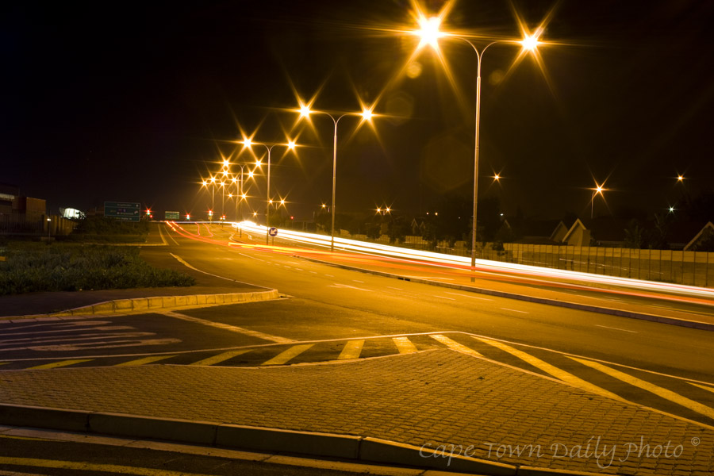
INTELLIGENT AND WEATHER ADAPTIVE SMART STREET LIGHTING CONTROLLING SYSTEM
INTELLIGENT AND WEATHER ADAPTIVE STREET LIGHTING SYSTEM
B.SAI RAM DHEERAJ
B.RADHESH SRI SAI
J.VENKAT

Slide 2
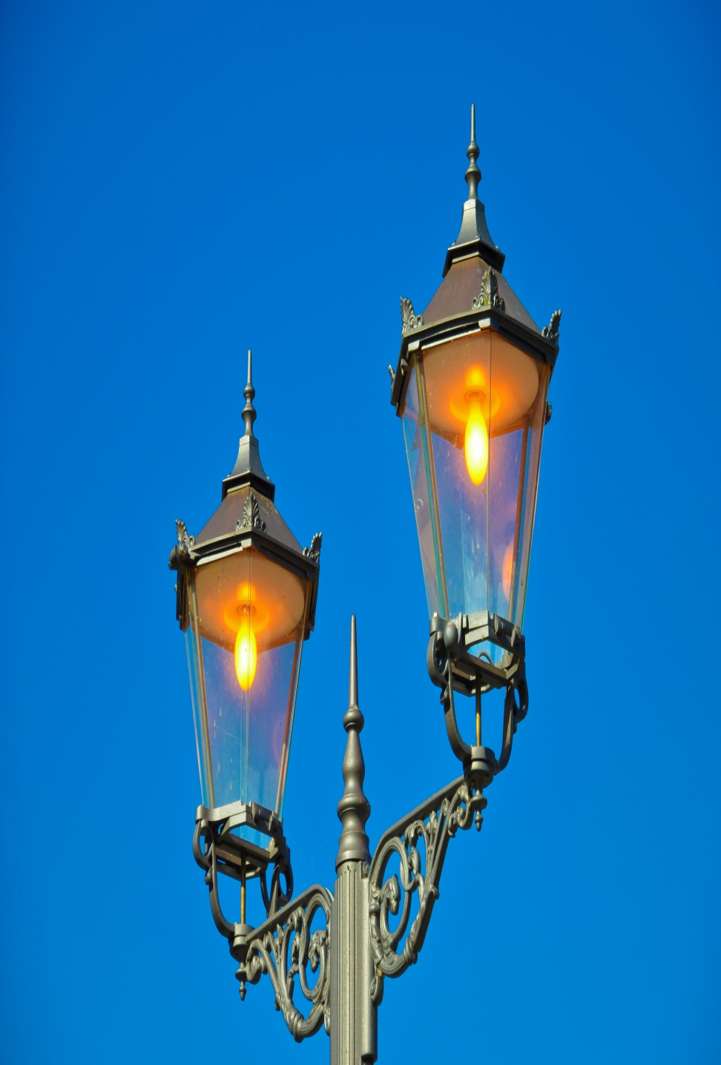
INTRODUCTION
The street lighting is one of the largest energy expenses for a city. An intelligent street lighting system can cut municipal street lighting costs as much as 50% - 70%.
An intelligent street lighting system is a system that adjusts light output based on usage and occupancy, i.e., automating classification of pedestrian versus cyclist, versus automotive.

Slide 3
An intelligent street light management proposes the installation of the wireless based system to control the actual energy consumption of the street lights and take appropriate energy consumption reduction measures through power conditioning and control

Slide 4
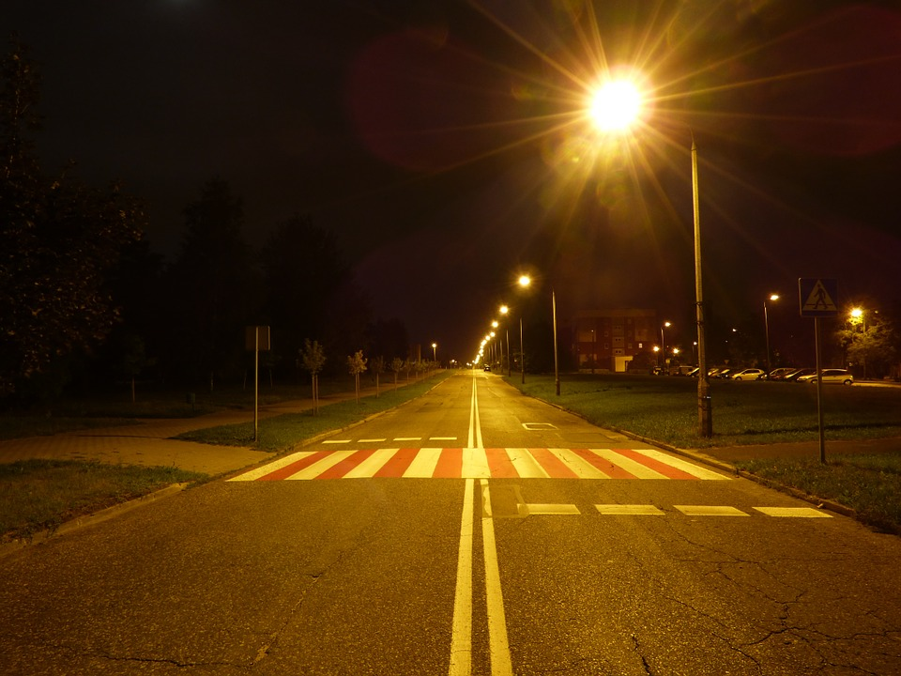
PROBLEM DEFINATION:
We have seen in the number of cities where the street lights is the one of the huge energy expense for a city. Currently we have manual system where the light will be switched ON in the evening before the sunset and they are switched OFF next day morning after there is sufficient light outside. So there is lot of energy waste between ON and OFF timing.

Slide 5
Disadvantages of Existing System :
Manual Switching off/on of Street Lights
More Energy Consumption.
High expense
More manpower
High expense

Slide 6
Advantages of the Proposed System :
Automatic Switching of Street lights.
maintenance Cost Reduction.
Reduction in CO₂ emission.
Reduction of light pollution.
Wireless Communication.
Energy Saving.
Reduction of manpower.

Slide 7
COMPONENTS USED:
LDR
LED
AURDINO SOFTWARE
NODE MCU(ESP8266)
NRF MODULE(For TX and RX)

Slide 8

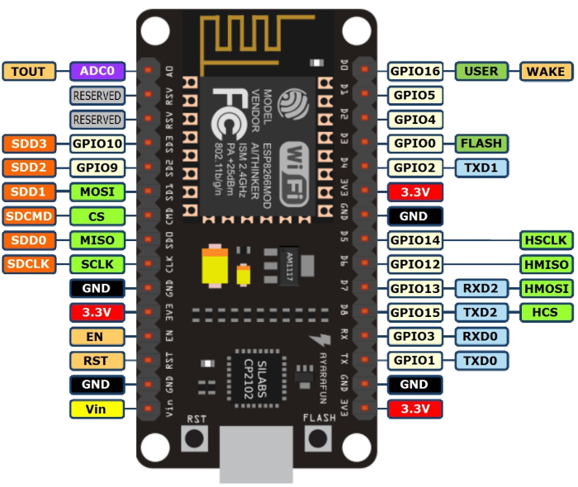
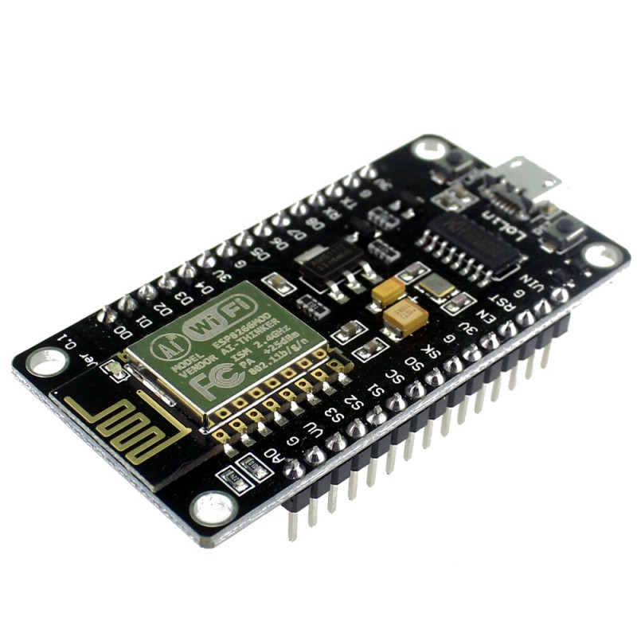

Slide 9
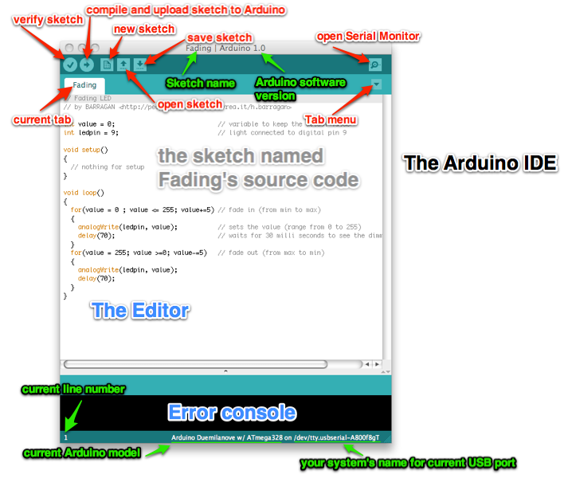
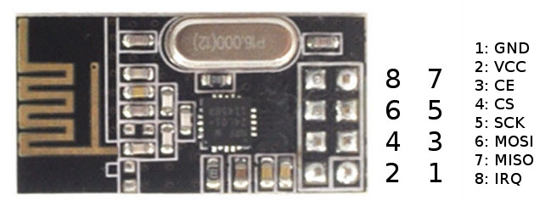

Slide 10
CONCLUSION:
This project Weather Adaptive Street Lighting system could be a price effective, eco-friendly and therefore the safest technique to save energy and through this method the light status data is accessed from anytime and anyplace. It clearly tackles the matter the planet is facing these days that’s, saving energy. The project has scope in varied alternative applications like for providing lighting in industries, campuses and parking lots of large spaces like malls.

Slide 11
